Slide 1
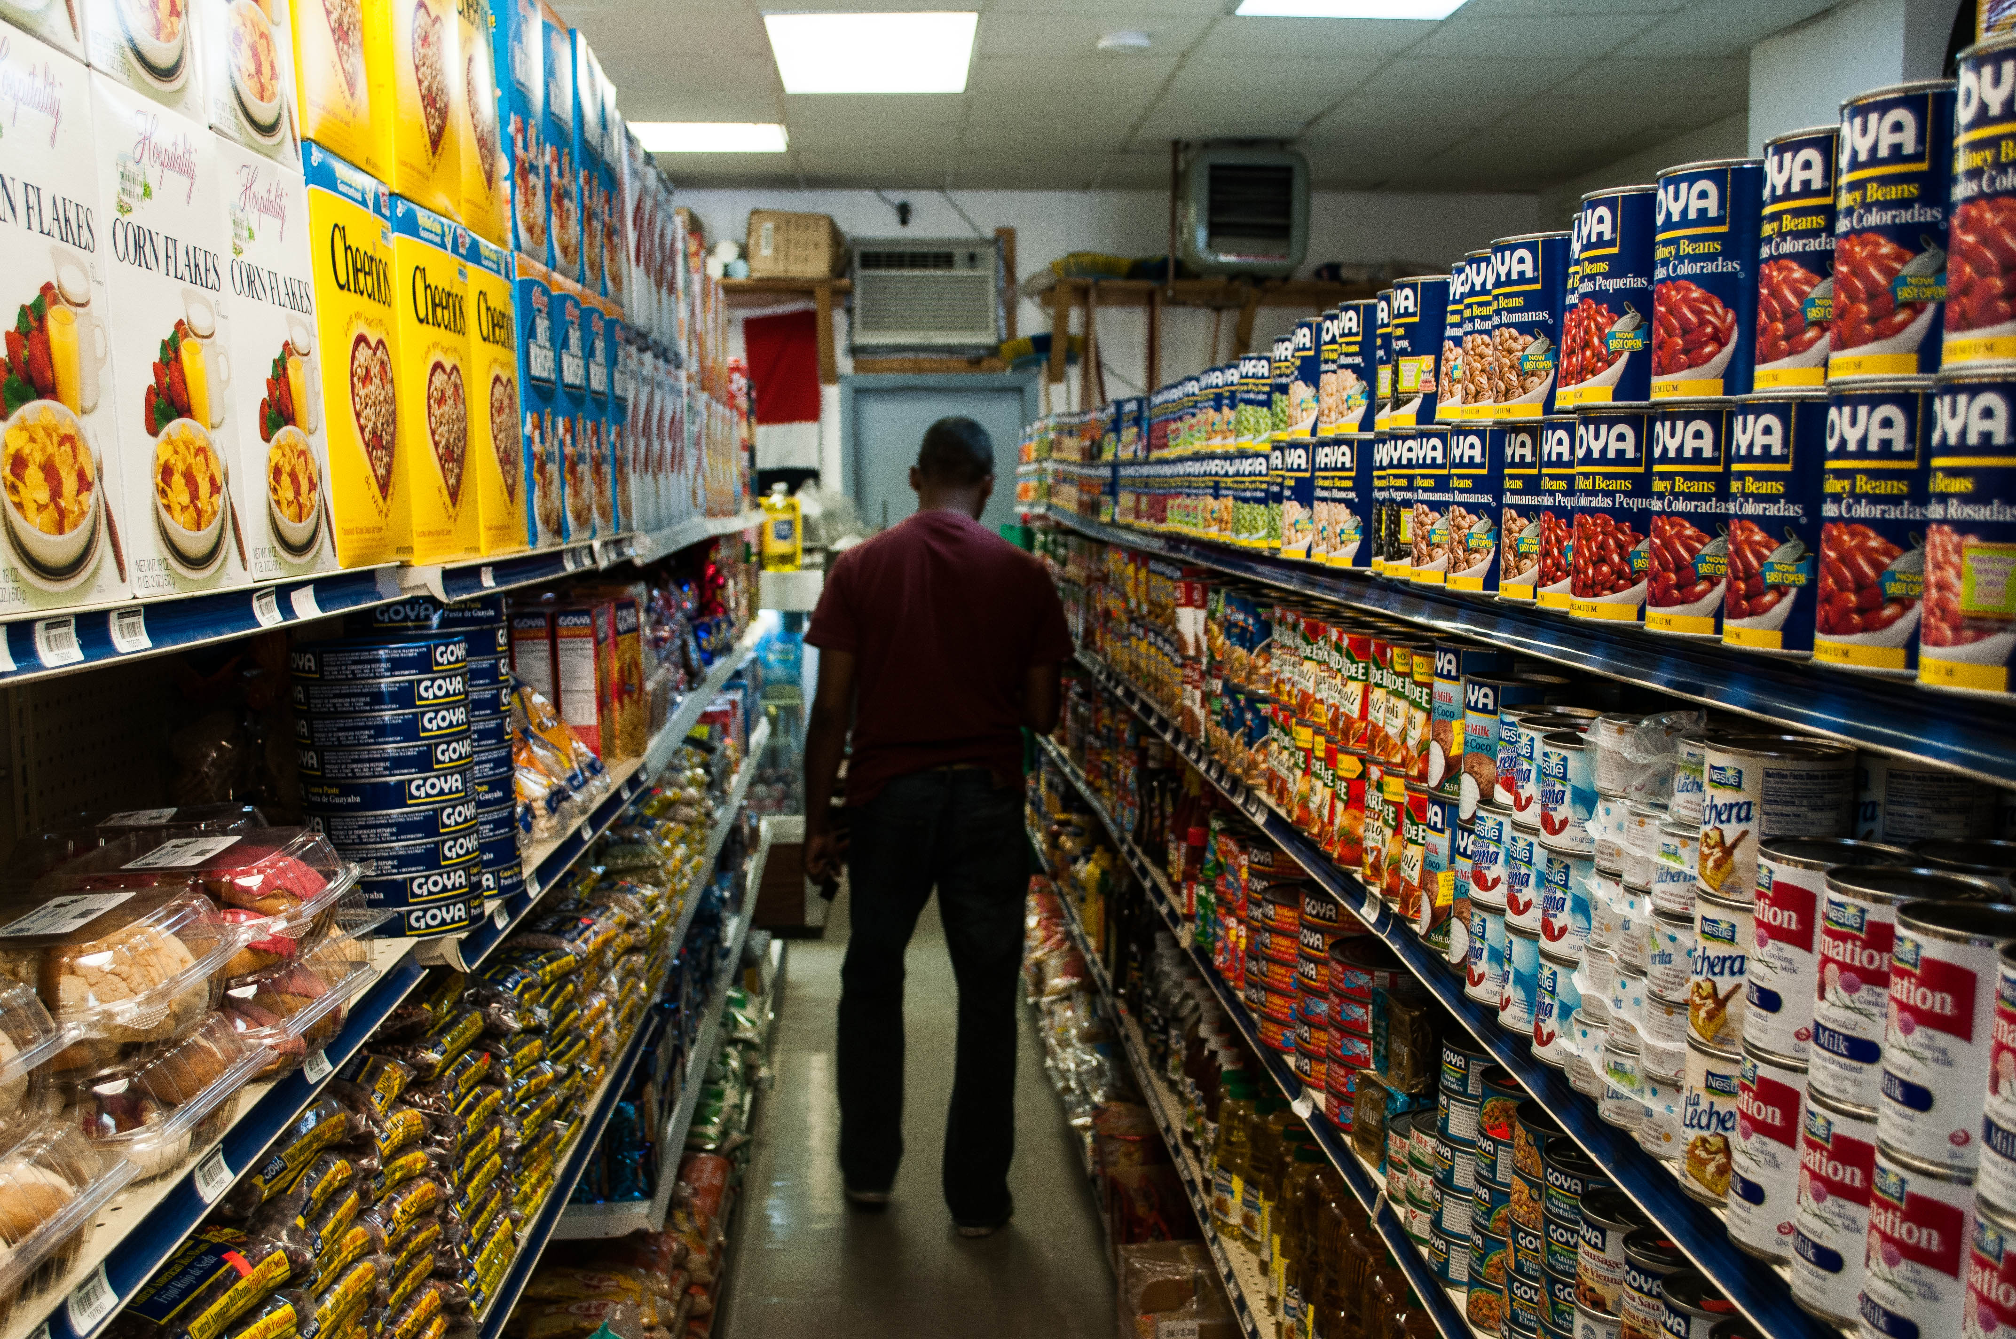
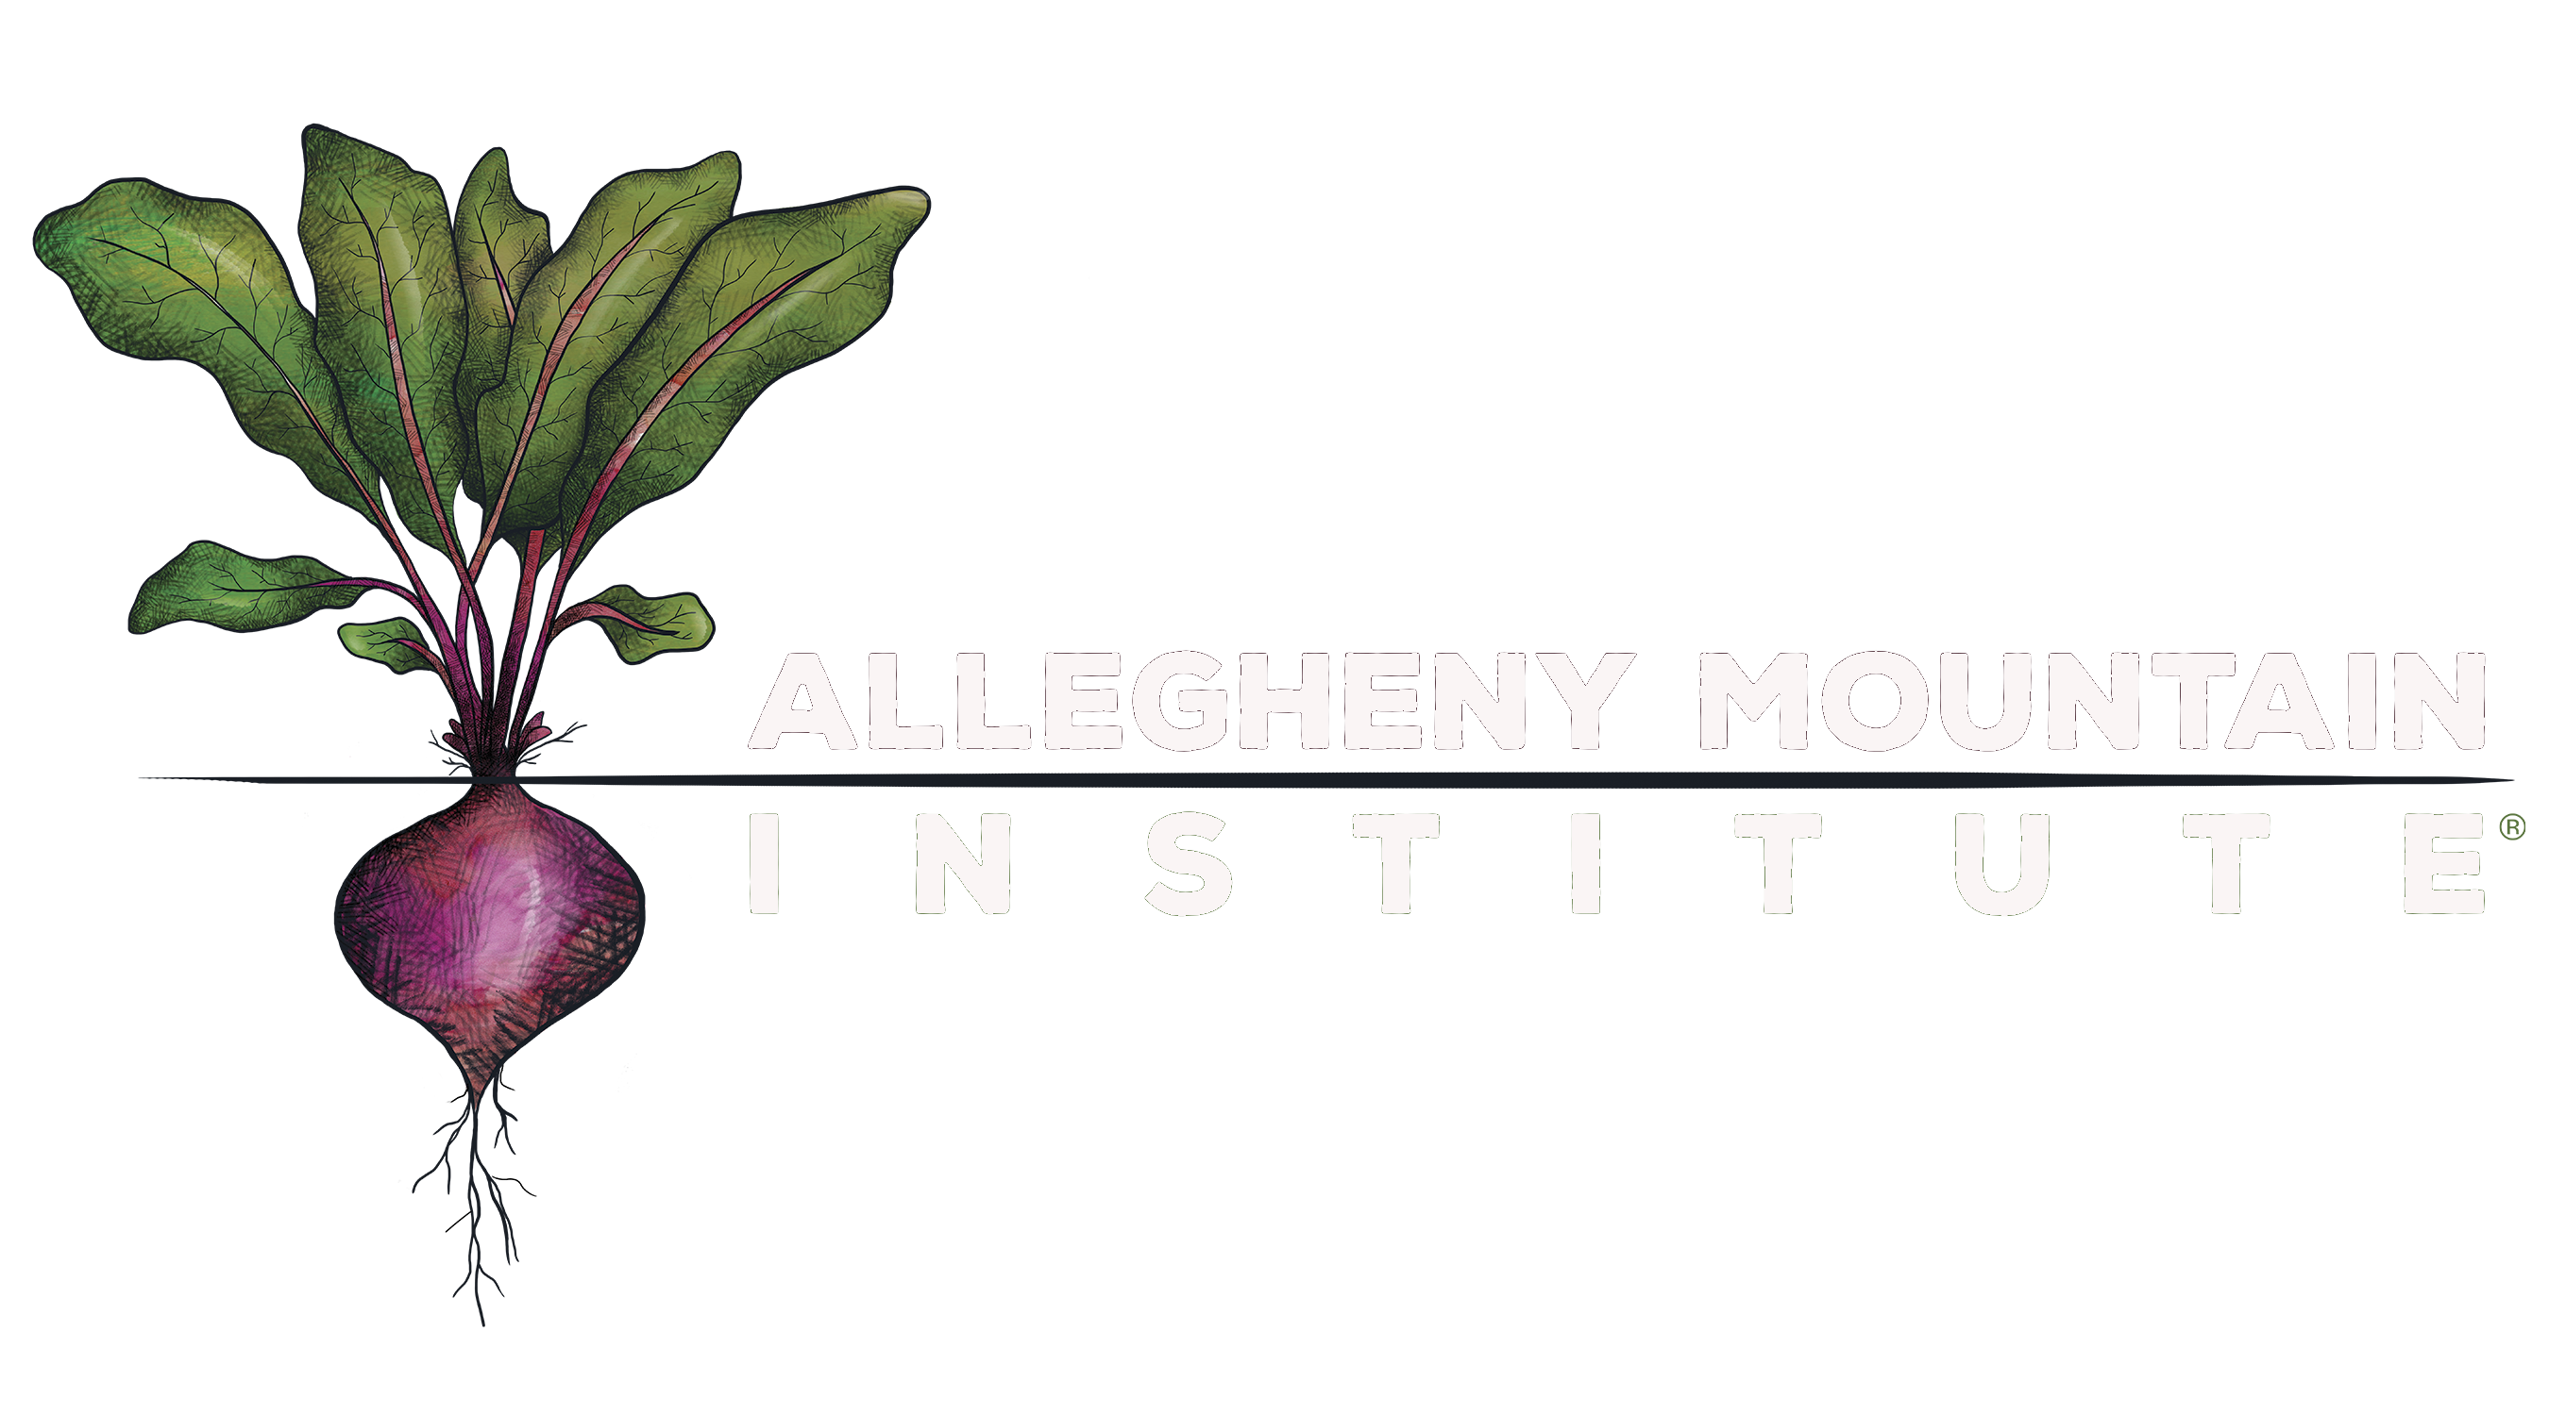

What is the Food System
And Where do I fit in It?
Grayson Shelor
Notes:
Welcome! The digital primer on food systems is brought to you by Allegheny Mountain Institute and the AMI Farm at Augusta Health. Keep your slides on this screen or use “presenter mode” to take advantage of the narration in this notes panel as you work through the slides.
A word of thanks: this course is adapted from material in the FoodSpan series, developed by the Center for A Livable Future at Johns Hopkins University.

Slide 2
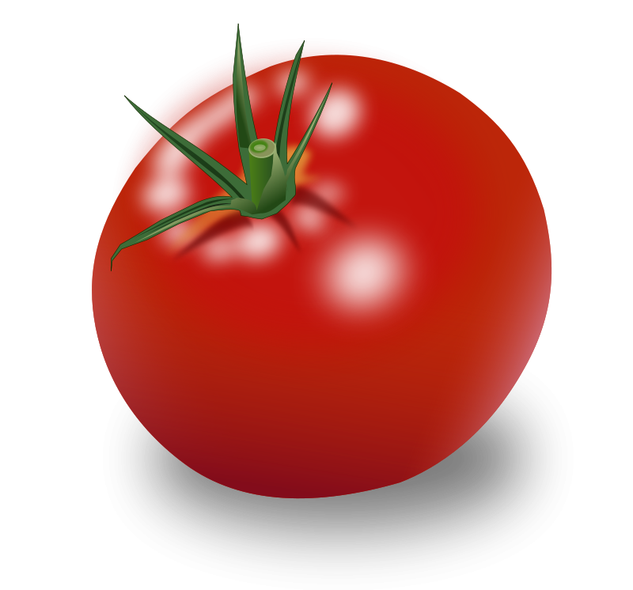
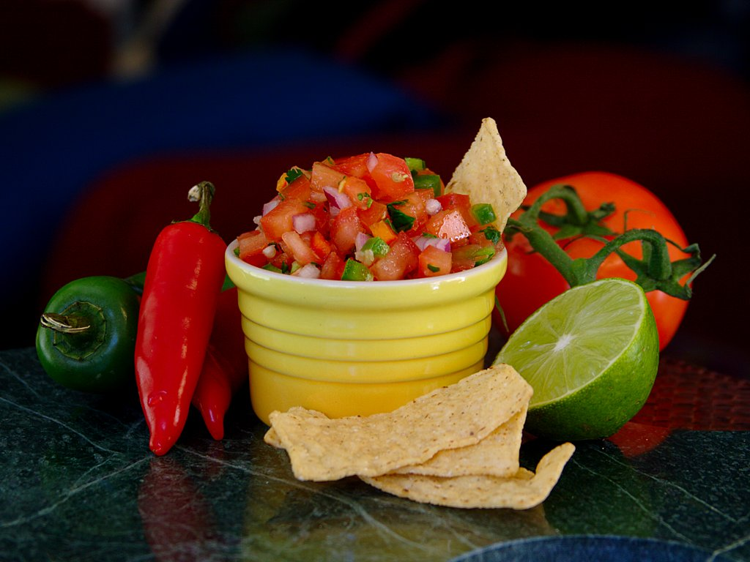
How many Hands Have Touched this Tomato?
What about this one?
Notes:
For any given food, we have a multitude of lenses we could use to consider it. Flavor? Nutrition? Cost? One of these factors, or a combination of all of them might be the most important to you when choosing what to purchase, cook, and eat.
But for the purposes of this lesson, let’s look at this tomato and that bowl of salsa in a new way, asking ourselves: “How many different human hands may have touched this food before it reached me?”

Slide 3
“an interconnected web of activities, resources and people that extends across all domains involved in providing human nourishment and sustaining health, including production, processing, packaging, distribution, marketing, consumption and disposal of food.
The organization of food systems reflects and responds to social, cultural, political, economic, health and environmental conditions and can be identified at multiple scales, from a household kitchen to a city, county, state or nation.”
Notes:
So to answer our question, first we need to define our jargon.
Here it is: the world’s wordiest definition of how we might understand the food system. According to researchers at the University of Vermont, the food system is, “an interconnected web of activities, resources and people that extends across all domains involved in providing human nourishment and sustaining health, including production, processing, packaging, distribution, marketing, consumption and disposal of food.” They go on to explain that food systems change as people and society change, and that you can define them at any scale.

Slide 4
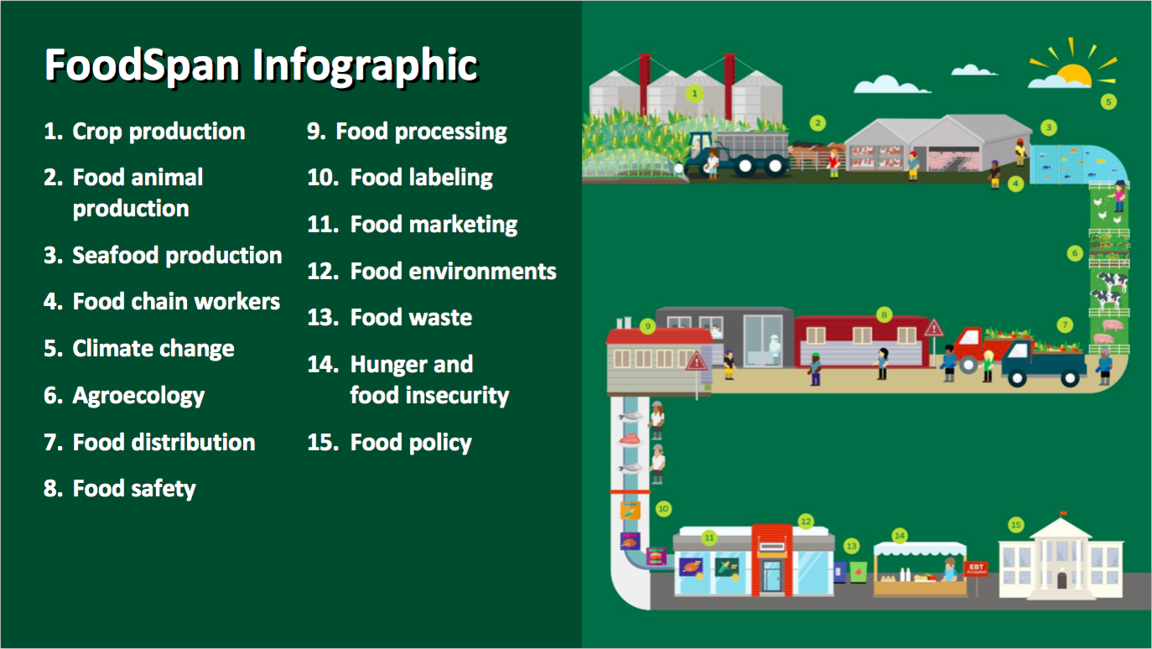
Farm to Fork
Notes:
Essentially, we might think of the food system as the path a food follows from it’s beginning at the farm where it grew, to it’s end on your fork. And it’s every step in between, including physical movement of food, like distribution, and laws and regulations, such as food safety laws, for example, the law that prevents the sale of raw milk in Virginia.

Slide 5
Activities
Choices
Production
Sanitation
Transport
Processing
Packaging
Labeling
Marketing
Purchase
Preparation
Consumption
Food Waste
Notes:
So if we return to our first slide, we have all of these activities, part of a web that touches every human hand and every law written that pertains to our theoretical tomato. From the field where it was grown, to the hands that picked and washed it, the truck it traveled on, the little plastic carton it sat in at the grocery store, to the reasons I chose to buy this tomato instead of the million other things on the aisles, we have a lot of activities, and a lot of incidences in which strangers touched my tomato. For the salsa, which was chopped, mixed, jarred, labeled, and advertised before it made its way to me, it’s even more extreme. And if, for whatever reason, I don’t eat them, if they land in my compost pile or waste bin, we add another aspect there, too.
But the point here is that activities is a static word, and this one-way arrow that is so often used to describe this journey of food can be misleading. What we’re looking at is more like a web, where every issue pulls three more into play. It’s messy. It’s complex. It’s also not set in stone the way that a diagram like this might lead you to believe. So for the purposes of our discussion, let’s focus not on what the food system has been, but what it can be. That means re-defining this web not as a series of activities, but rather of choices.

Slide 6
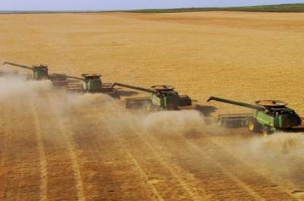
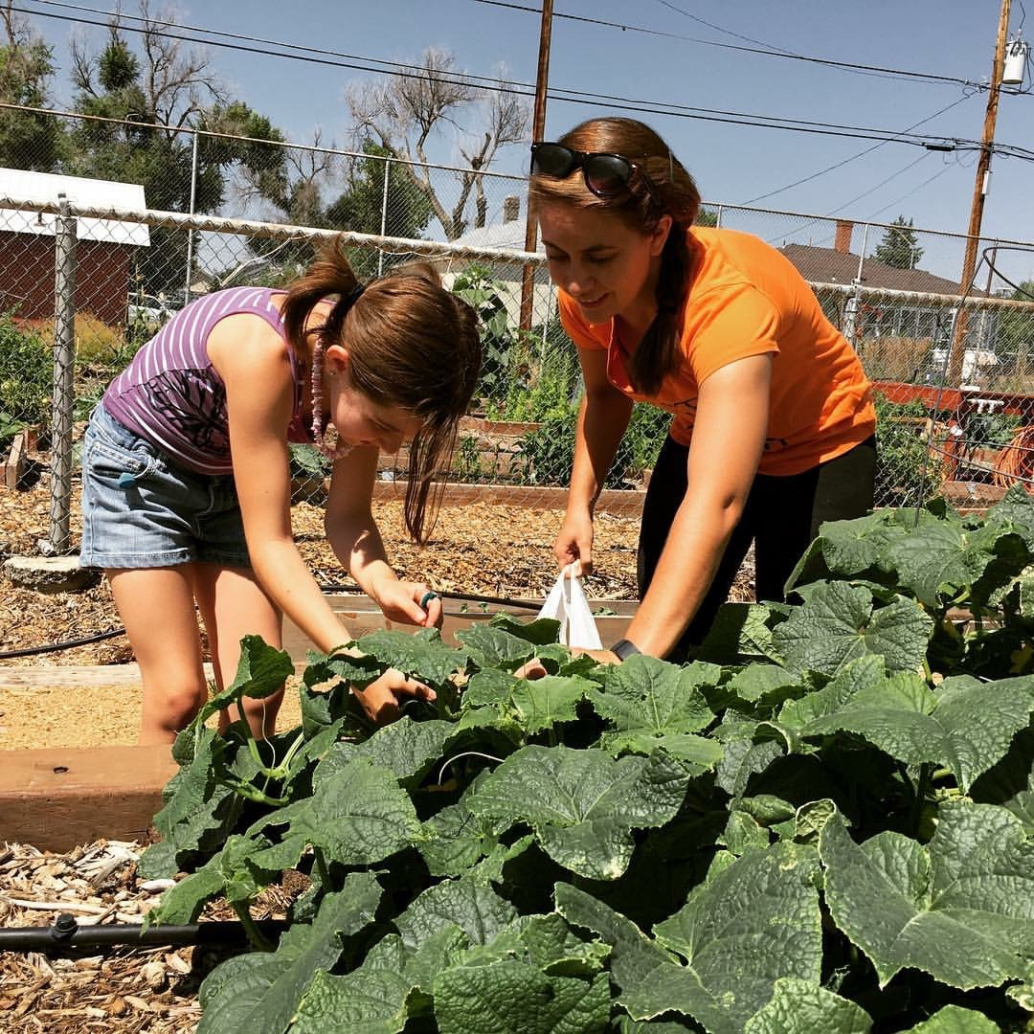
Industrial vs. Alternative Agriculture
Transparency
Notes:
Here’s our first choice: How our food was grown. On the left-hand side you have commercial, industrial agriculture. On the right you have alternative agriculture—in this case a community garden that uses organic practices. I know, because yes, that is a picture of me, and I can tell you every soil amendment, growing practice, and eco-friendly spray that touched those zucchini. That’s the kind of control that you have when you grow your own food, or if you can find the person who grew it.
And that’s the point that I want to make about industrial agriculture. When I look at that picture on the left, I have questions. Getting them answered is nearly impossible. The industrial food system was designed to be highly productive and efficient, and it does those things well. It was not designed to be transparent. So the farmers on the left may be admirable. They might be spraying the purest spring water on their fields of corn, and if they are, I’d like to support them by buying their products. But if that corn continues into the system, it’s lost among the masses.

Slide 7
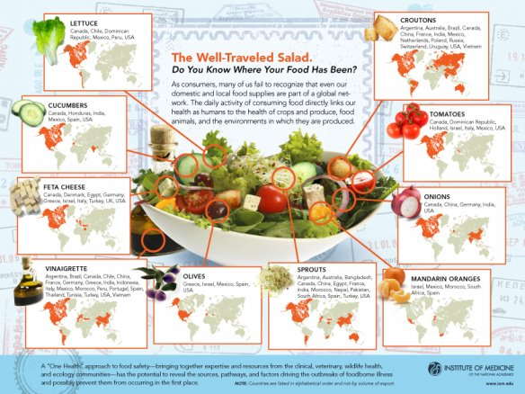
Food Miles
Seasonality matters: Notice the Alaskan tomatoes?
Notes:
So here’s our next option. How far has our food traveled to reach aisle 4?
This is a favorite image of mine: the well-traveled salad. It is kind of a captivating idea, isn’t it, that the ingredients in lunch might have seen such far-flung places. But when you factor in the fossil fuels involved in the transportation industry powered by that salad, it doesn’t seem so fresh. And take a closer look at those maps. See our tomatoes? That they might have come from anywhere in North America, including Alaska? Not likely, if I’m eating the salad in March. So when we eat out of season, we can count on even higher tallies of food miles, and an even deeper carbon footprint.
Let’s also pause here to talk about economics. I’m not a numbers person, so we’ll keep it simple. If I’m a restaurant owner, and my olives are from Greece, and my mandarin oranges from Mexico, it’s unlikely I’m negotiating with individual buyers. That means some of my money is going to Greece, and some to Mexico, but more than likely, a big chunk of it is going to a multinational corporation headquartered in some other place. It’s not staying in my community, for sure. The truck drivers bringing it into town are not my neighbors. The people who packed it into crates can’t tell me about the soil where it was grown. So we’ve missed the chance to do good for the planet and for the community. Imagine, then, the flipside, the change we could be fashioning if we switched even one of those salad ingredients for a local alternative.

Slide 8
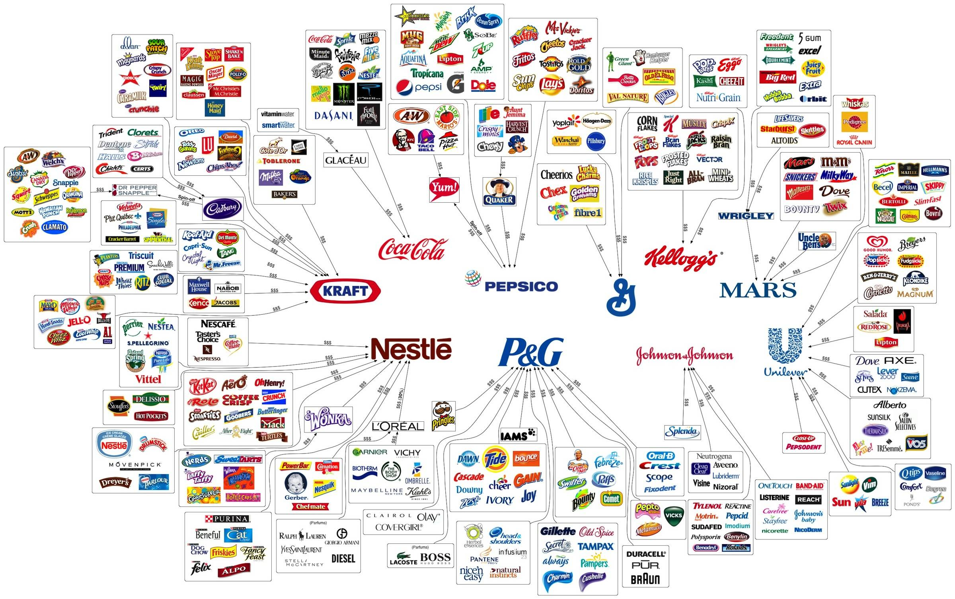
Big Food
Notes:
So far we’ve been looking at issues that apply to produce and processed foods alike, but let’s take a closer look at the inner aisles of your local supermarket. Those are the aisles where everything is canned, boxed, plasticked, and shelf-stable. And almost everything you find there is owned by just a handful of companies. Check this out for a moment.

Slide 9

Shelf Life
Preservatives
GMO
Irradiation
  “Food Irradiation: What You Need to Know
Irradiation does not make foods radioactive, compromise nutritional quality, or noticeably change the taste, texture, or appearance of food. In fact, any changes made by irradiation are so minimal that it is not easy to tell if a food has been irradiated.”
Notes:
And how do they make our food shelf-stable, you ask? There are so many ways.
This information on irradiation, by the way, is straight from the FDA webpage. The round icon should appear on any food that has been irradiated.
A note, too, on genetically modified organisms: you might feel, as I once did, that it ought to be preferable to have our food modified at the genetic level, rather than a chemical one. With that understanding, I was willing to embrace GMOs as a beneficial alternative that reduced pesticide use. Unfortunately that belief was founded on a misconception. In truth, Genetically Modified Organisms see a higher rate of pesticide use than comparable non-GMO crops. And their health effects on our bodies simply aren’t known yet.

Slide 10
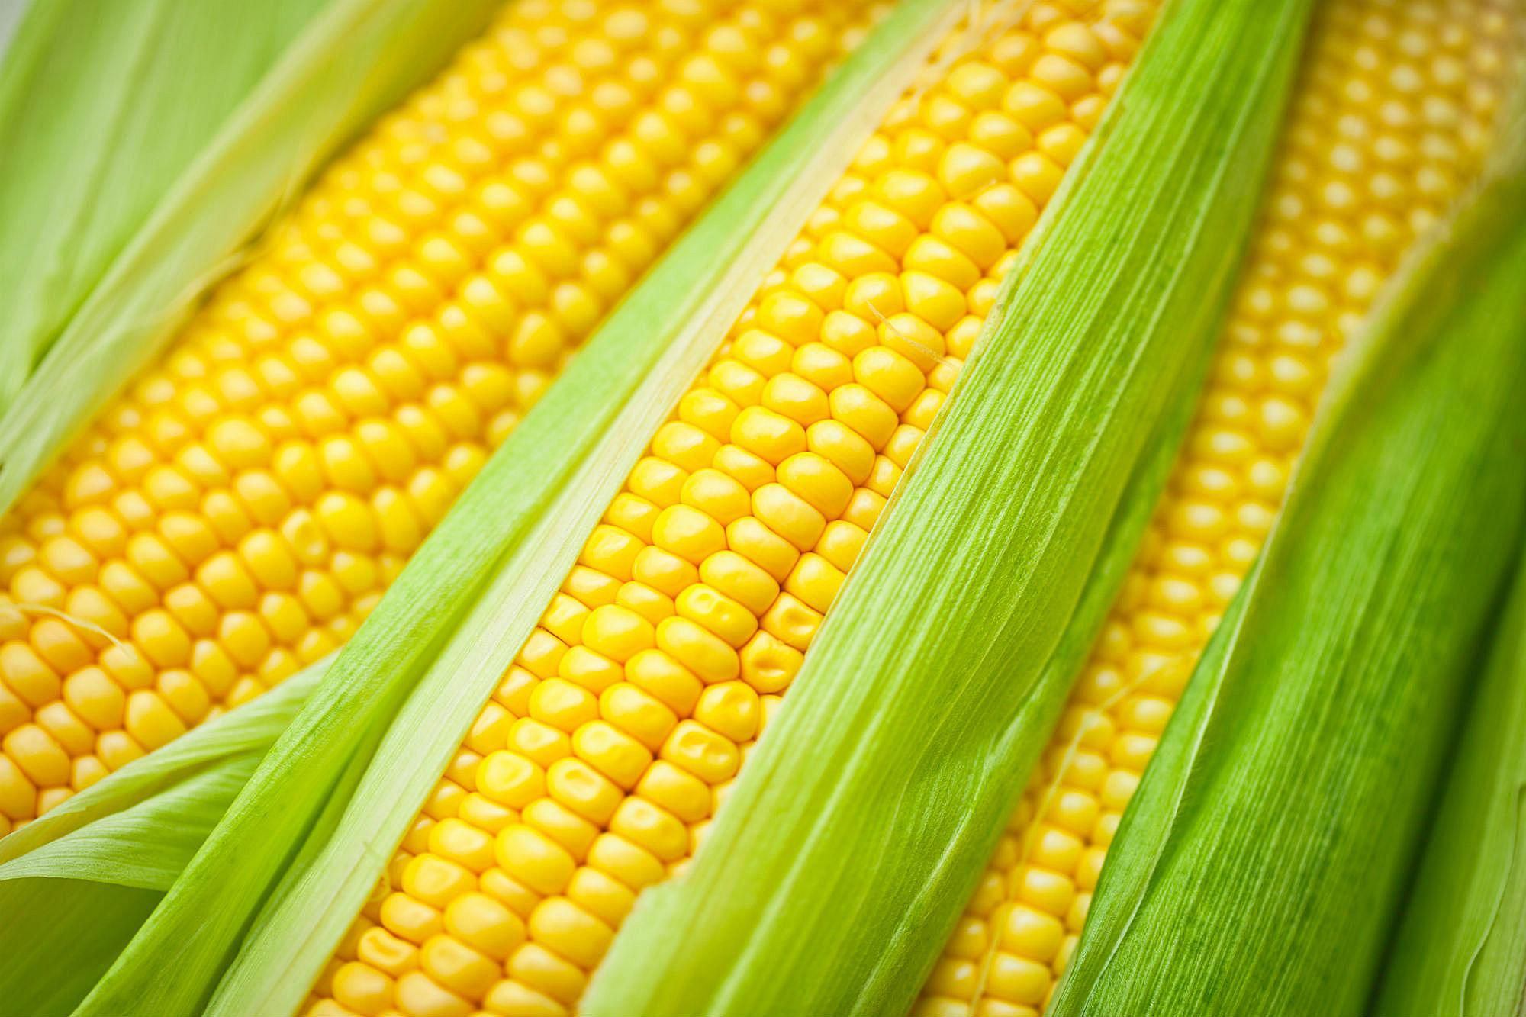
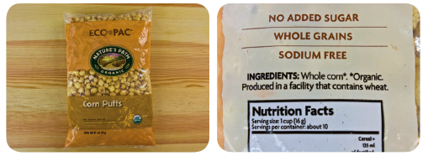
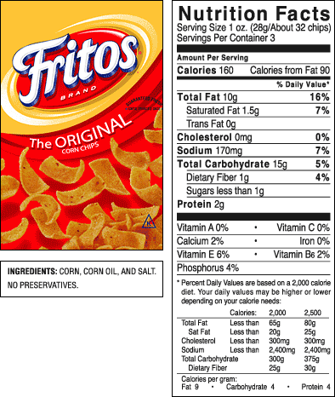
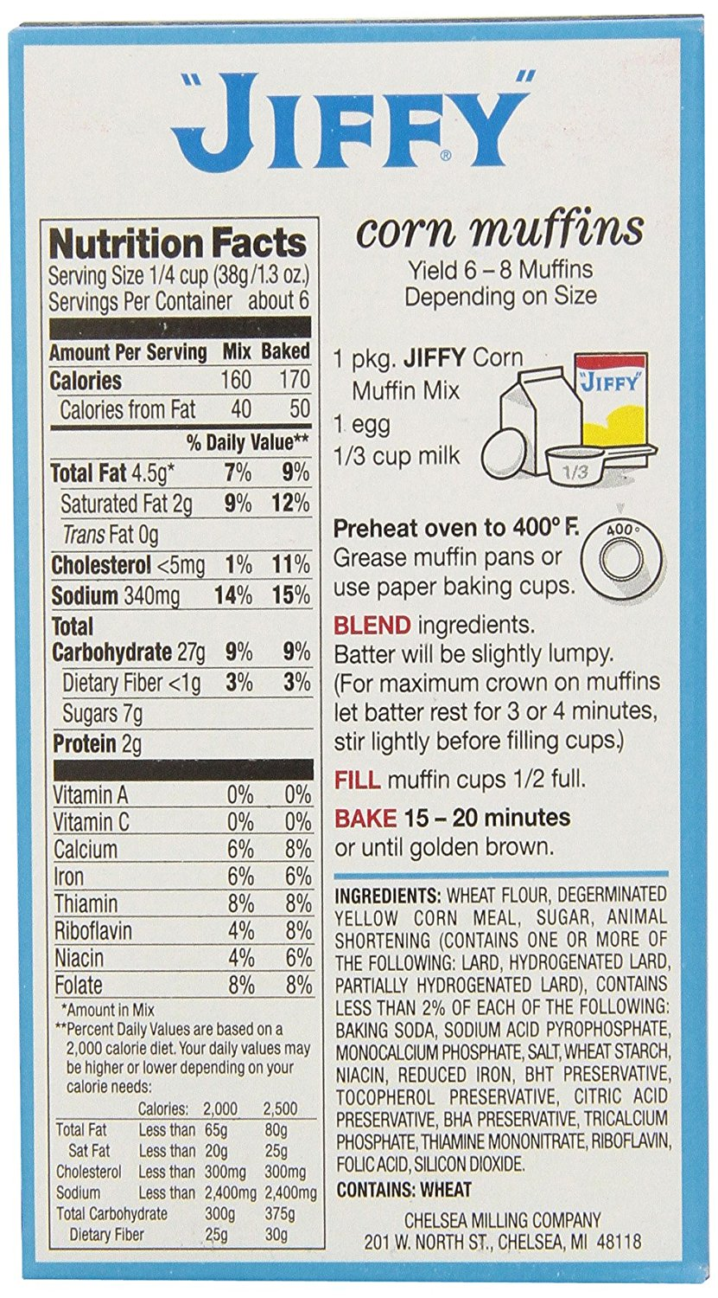
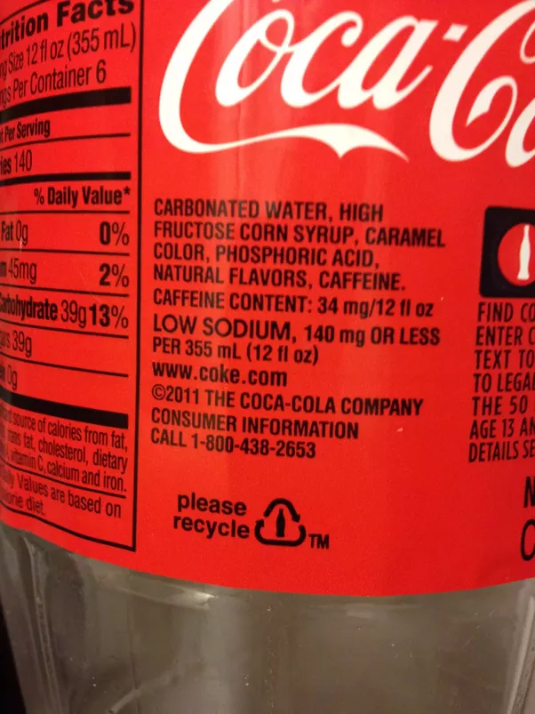
Processed Foods
Notes:
And of course, anything processed has a longer shelf life too. Here’s a closer look at what processed foods actually means. From fresh corn on the cob, to these corn crisps with only air added, on down, each product raises the number of ingredients, adds more chemicals I can’t pronounce, and looks less and less like corn.
Let’s pause here to remember the industrial farmer we talked about earlier, who may or may not have been spraying something shady on his fields. Let’s say his corn was bought up by a wholesaler, destined to become high fructose corn syrup. It’s now been mixed with corn from different growers across the nation, whose practices I also cannot vouch for, and is likely flowing through a bottle of coca-cola somewhere in the USA. Maybe a million bottles. And if I want to avoid it, I have two options: abandon coke products, or try to change policy.
If you’ve heard anything about Subsidies in agriculture this is where they come in. We sweeten with corn because we have a lot of corn. We have a lot of corn because we pay farmers to grow corn. It’s a vicious cycle, and again, it goes back to policy.

Slide 11
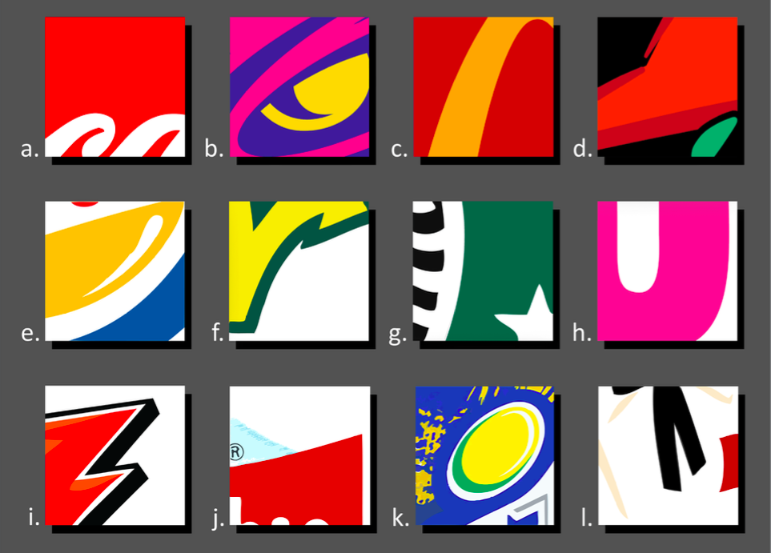
Marketing
Notes:
Okay, POP QUIZ! In one minute, can we name every brand?
Do you notice how much red and yellow appears on this page? On the last page too, but we might assume the yellow there was to remind us that despite appearances, those products were once corn. In fact, it’s because the food industry has researched your brain, and what they discovered is that red and yellow stimulate our appetites.
The next time you have a craving for junk food, don’t blame yourself. It’s science!
Another trick that fast food companies use? Their set up convinces you that you’re in more of a rush than you actually are. When you choose faster and eat faster, you pay less attention to the nutrition or ethical value of what you eat, and you eat more of it.

Slide 12
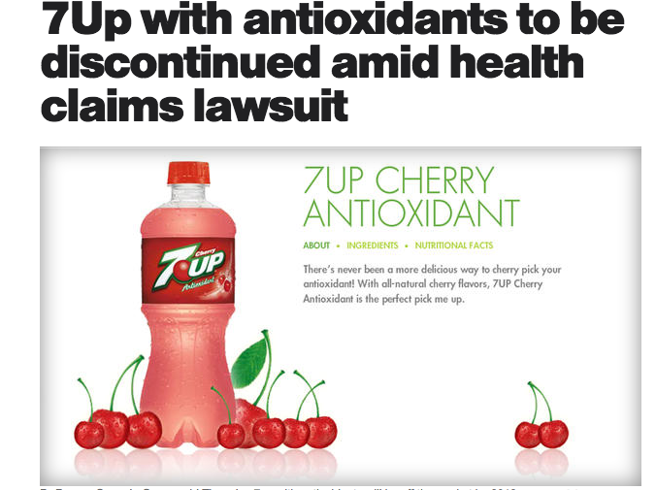
Marketing
Notes:
The same tricks are also in play at the supermarket. One of the biggest ones to look out for is dodgy health claims, like this one for 7Up plus antioxidants. There may have been some antioxidants in there, but they came from artificial sources, because Cherry 7Up contains 0% juice. It’s a similar story with the labeling of new ‘Gluten Free Rice Chex’ and All Natural Lays Potato chips. Rice Chex were always gluten free—they’re made of rice. And Lays didn’t change the recipe for their potato chips, they just took advantage of our growing interest in natural foods.

Slide 13
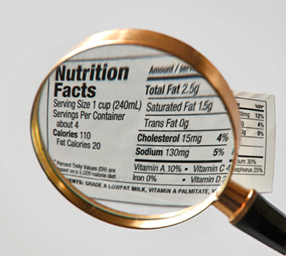
Labeling
Notes:
I won’t talk a lot about reading nutrition facts here: that is a separate class and best explained by a health professional. But I do want to draw your attention to serving size, because it is one more way you might get tricked if you aren’t eating conscientiously. For example, a chief offender here is Pop Tarts.
I also want to bring us back to our earlier look at industrial and organic agricultures. Because while I am not a dietician, the truest and most applicable advice I often give folks who want to eat better, is to eat more produce—the foods that don’t need a nutrition label. But it’s worth mentioning that there are definite nutrition differences in produce too. Plants reflect the soil they grow in, and nutrient-poor, depleted soils create produce that is largely water. Whereas healthy, vibrant soils, the result of wise management, create produce with higher concentrations of a more diverse range of nutrients.

Slide 14
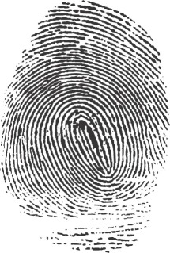
Why We Eat What We Eat
Notes:
What we see impacts what we eat. In fact, research has shown that the average person makes over 200 decisions about food per day. So what is the deciding factor in what we put on our plates?
Well, it turns out, it is different for each of us.
Community Mapping Activity:
Map a community you’ve lived in, including the resources that were most important to you. Pay special attention to the things that influence(d) your eating habits. (10 Minutes)
Now, looking at what you drew, let’s make a list of influences: our food environment. (Family, distance to stores, restaurants, advertising, culture)
Are you living in a Food Desert?

Slide 15
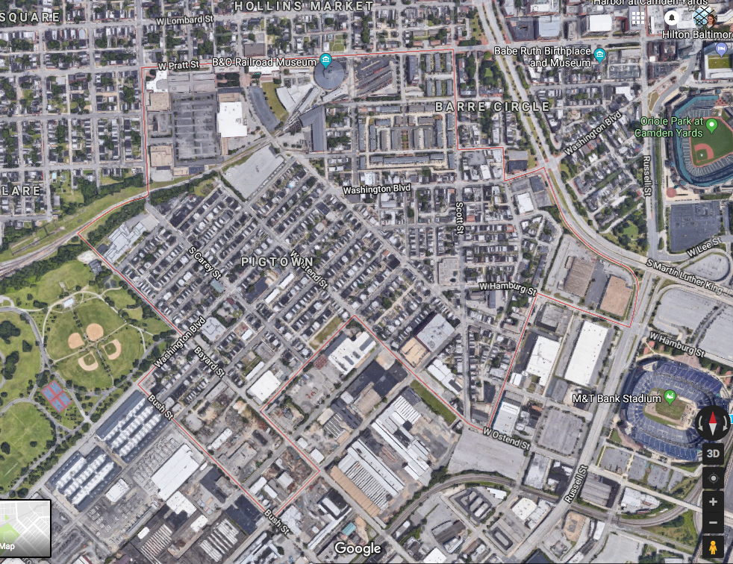
Food Deserts and Food Swamps
Notes:
This is the neighborhood of Pigtown in Baltimore. For years it was the 7th most dangerous neighborhood in the country, and for most of those years it was a food desert. Pigtown is changing. It now has a full-service grocery store, and in the last three years it has gotten a farmers’ market.
Pigtown has been upgraded to a food swamp. That means that to get to the grocery store, you’d have to pass at least 10 corner stores offering soda and twinkies. In a neighborhood where much of the population is on foot, that kind of thing matters.
This is all too common in our cities, and it disproportionately affects low-income communities of color. All too often, these are the same communities struggling with high incidences of diet related disease like diabetes. Food environments are making Americans sick and sabotaging their efforts to get better.

Slide 16
The Extension: Food Justice
“Food justice is the belief that healthy food is a human right, so everyone has an inherent right to access healthy, fresh food. Access is a mixture between location, affordability, and cultural appropriateness. Food justice is important for everyone because food is culture. Food is your family. Food is part of how we communicate with one another; it’s a way we share our love.”- Nikki Henderson
Notes:
When we agree that things like that are wrong, we’re engaged in a new fight: the fight for food justice. This is activist Nikki Henderson’s beautiful definition of food justice: “the belief that healthy food is a human right, so everyone has an inherent right to access healthy, fresh food. Access is a mixture between location, affordability, and cultural appropriateness. Food justice is important for everyone because food is culture. Food is your family. Food is part of how we communicate with one another; it’s a way we share our love.”

Slide 17
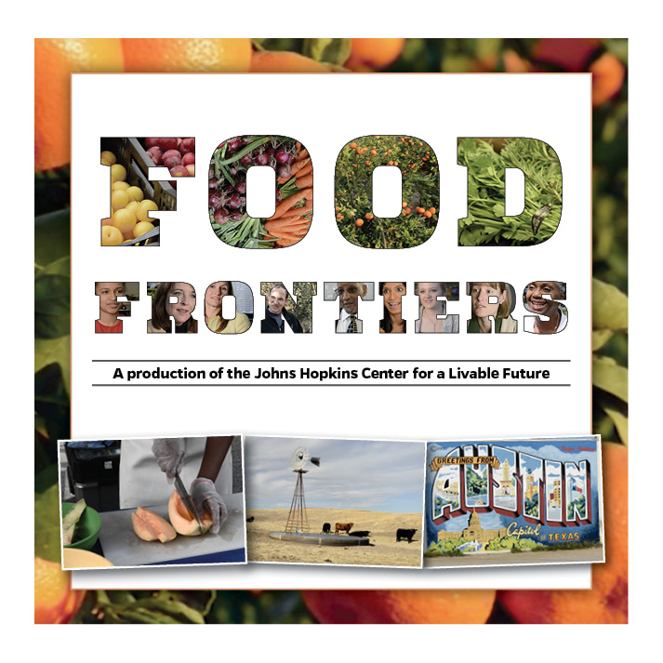
Around the Nation
Watch!
Notes:
Here are a few more stories from inspiring efforts to spread food justice. This documentary, Food Frontiers was produced by the Center for a Livable Future at Johns Hopkins University, and it explores 5 different organizations who approach the problem in innovative ways. I encourage you to watch the whole thing if you have time. It’s on youtube.

Slide 18
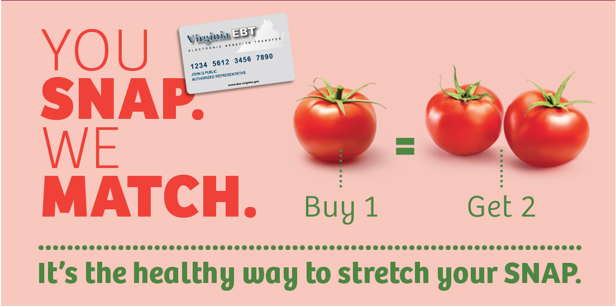
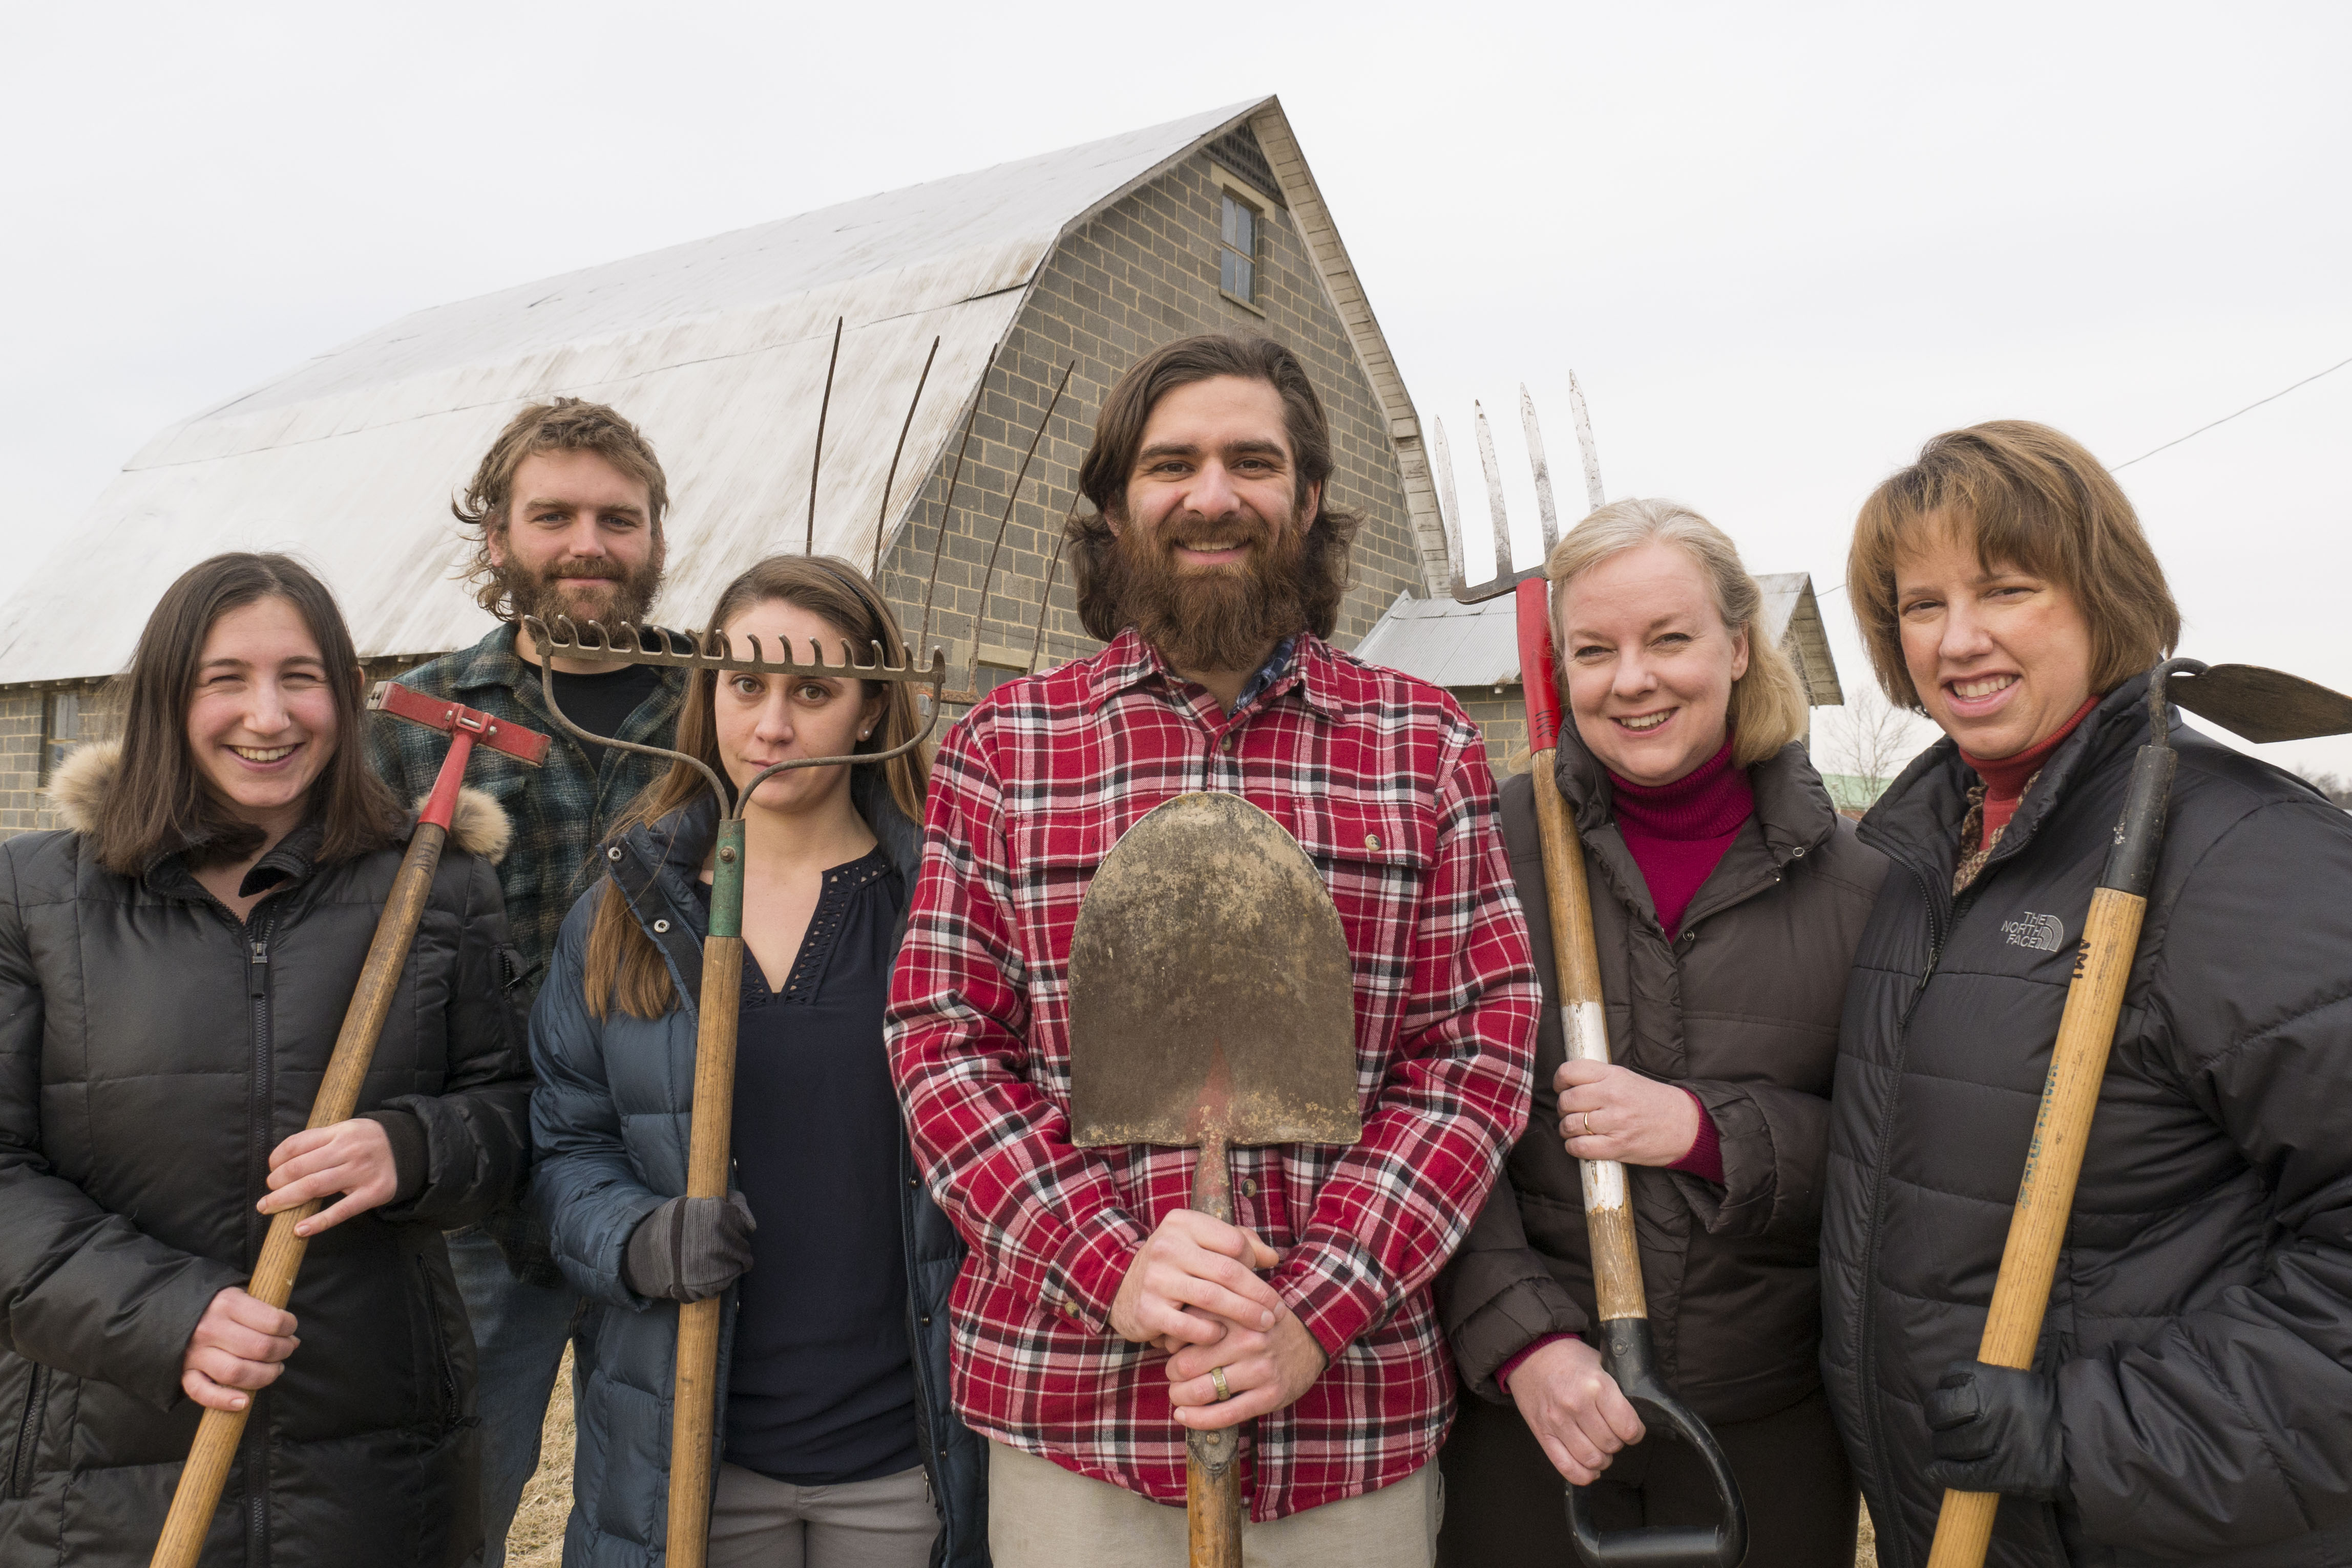
Our Community
Notes:
We shouldn’t forget our own community, either. One of the nationwide efforts represented locally is the Snap Match, or Double Up Food Bucks program. It allows SNAP (or Food Stamps) users at the Farmer’s Market to buy twice as much. Because fresh produce should be affordable if we want a healthy community.
And here’s a plug for our project: the AMI farm at Augusta Health. In addition to teaching classes like these, we’re also growing real, fresh, organic produce for hospital dining, and working to build up our local food system. This year we’ll be continuing our Food Farmacy program for at-risk patients, which matches nutrition education with free fresh produce and the help to use it well, in order to help patients manage their care. We’re here because we love food: growing it, eating it, and the way it brings people together, and we’re working to use it to make our community healthier. And we believe if you are conscious of your food choices, you’re a part of the movement too.

Slide 19
What’s Next?
How many hands touched our tomato?
It depends on you.
Visit a farmers’ market!
Join a CSA!
Grow your own!
Volunteer!
Shop with thought!
Evaluate!
Notes:
So use your choices well!
Want to talk food systems with the folks at Allegheny Mountain Institute? Send me an email at grayson@amifellows.org. I’d be happy to chat about AMI’s mission and programming, the AMI Farm at Augusta Health, and all our upcoming classes and ways to get involved. I can also connect you to local food organizations and vendors.

Slide 20
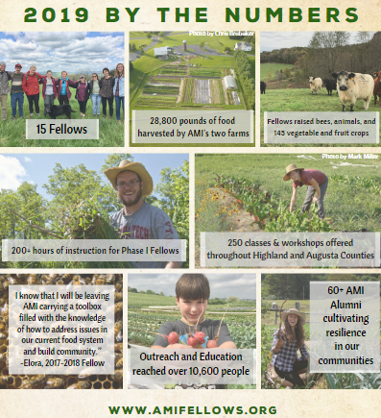

  Allegheny Mountain Institute (AMI) seeks to build healthy communities through food and education. We accomplish this mission through our educational Farm and Food Fellowship, along with the AMI Farm at Augusta Health: a farm to hospital initiative that nourishes and teaches the hospital and community.
Notes:
And check out www.amifellows.org for more interactive classes! Additional courses will be added as they are created. You can also follow us on facebook and Instagram to stay up to date with all things AMI!

