Slide 1


Sneaky Science:
Food Labeling, Choice, and Nutrition
The AMI Farm at
Notes:
Welcome to this e-class on the psychology of food marketing, brought to you by Allegheny Mountain Institute and the AMI Farm at Augusta Health!
This slide set is best experienced in ”presenter view” to take advantage of the narration here in the notes section, as well as testing yourself with challenge questions throughout the class. You should find ”presenter view” under the ”Slide Show” heading in the top PowerPoint menu bar.

Slide 2
“We do not make food choices in a vacuum. ... We may believe that we make informed decisions about food choice, but we cannot do so if we are oblivious of the ways food companies influence our choices.”
– Marion Nestle
Notes:
Food for thought from Marion Nestle, author of the landmark book in this field, Food Politics.

Slide 3
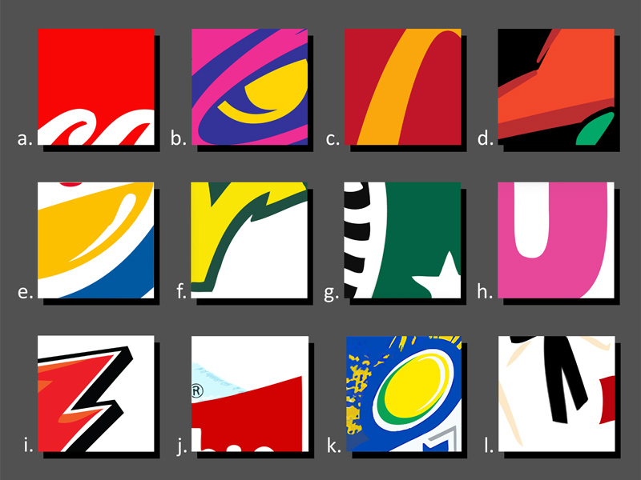
Notes:
Pop Quiz! How many logos can you name in one minute?
Adults do well at this… children do even better. And it’s not because those children are using their buying power, but because these images are Everywhere. And every time we see them, they are designed to change our thinking.
Hungry or thirsty yet?

Slide 4
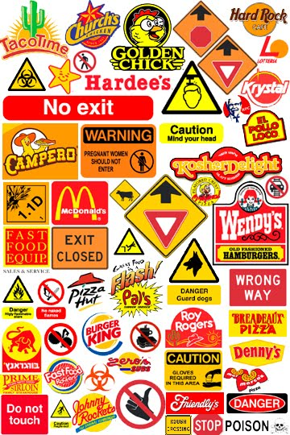
Tricks of the Trade
Red and Yellow
  Appetite
  Urgency
Notes:
Have you noticed how many of those labels and logos were either red or yellow? Red and yellow are dominant throughout the industry for a variety of reasons. This graphic demonstrates the logical way they signal urgency for our brain through their similarity to so many time sensitive messages that surround us on a daily basis.

Slide 5
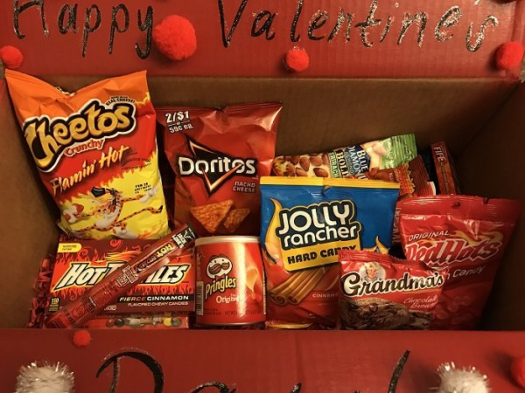
RED
Appetizing, Eye Catching, Urgent
Notes:
Can you guess what the use of red in labeling is designed to signal to your brain? (Click to the next slide to reveal)

Slide 6
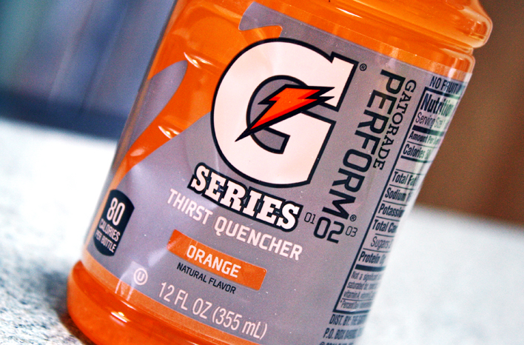
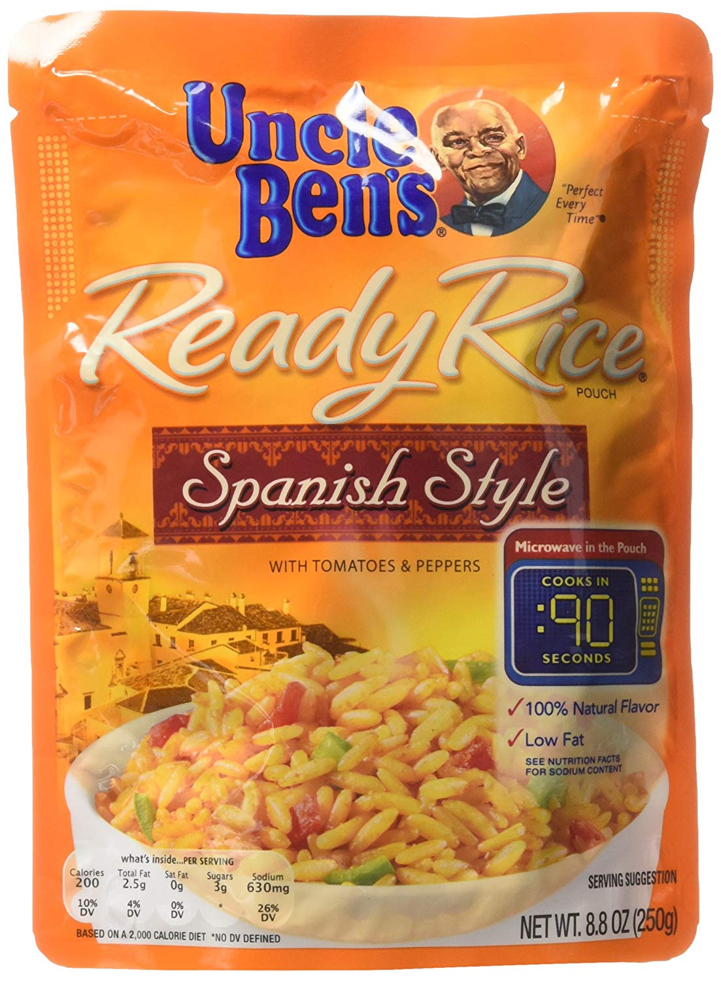
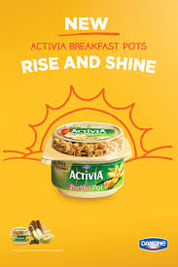
ORANGE
Invigorating, Energizing, Satisfying,
Affordable
Notes:
Can you guess what the use of orange in labeling is designed to signal to your brain? (Click to the next slide to reveal)

Slide 7
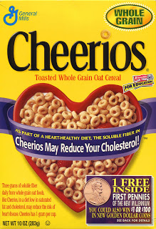
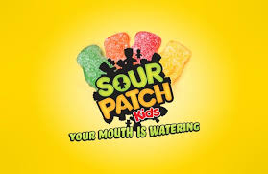
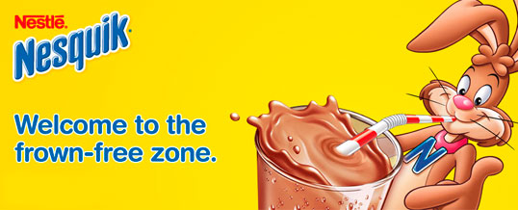
Yellow
Happy!
Notes:
Can you guess what the use of yellow in labeling is designed to signal to your brain? (Click to the next slide to reveal)

Slide 8
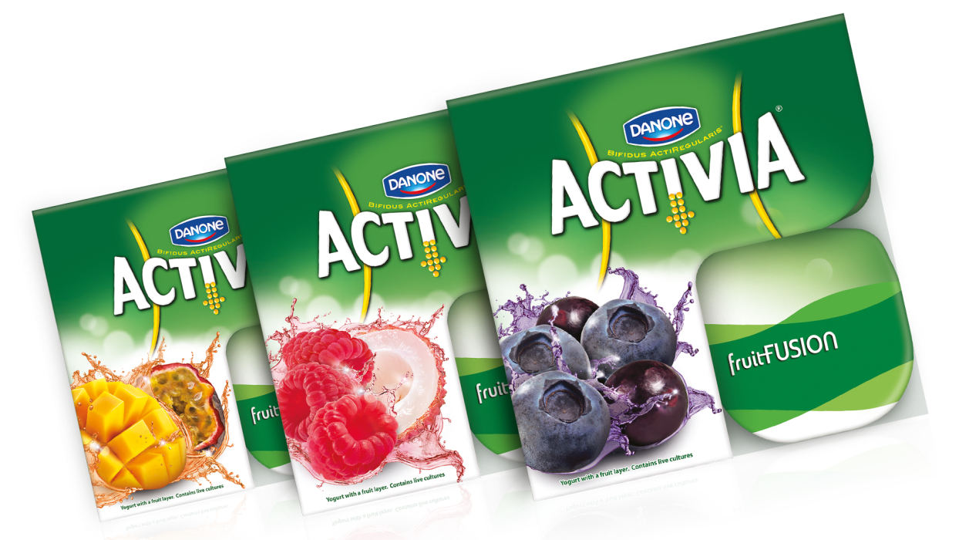
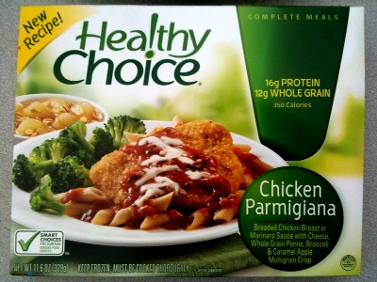
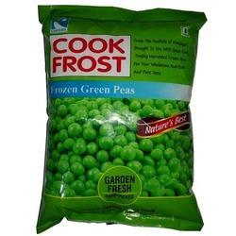
Green
Natural, Healthy,
Budget Friendly
Notes:
Can you guess what the use of green in labeling is designed to signal to your brain? (Click to the next slide to reveal)

Slide 9
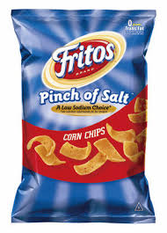
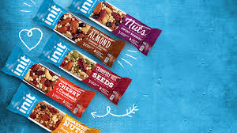
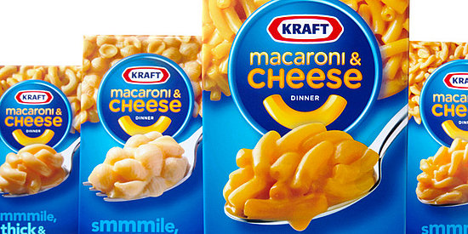
Blue
A Lighter Option
A Trusted Brand
Notes:
Can you guess what the use of blue in labeling is designed to signal to your brain? (Click to the next slide to reveal)

Slide 10
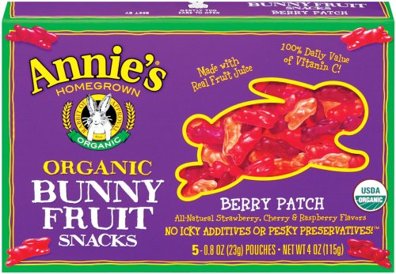
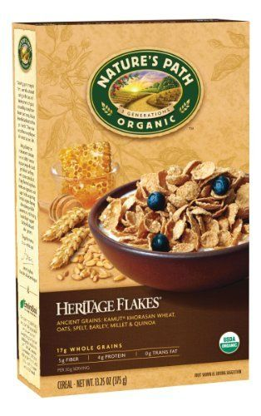
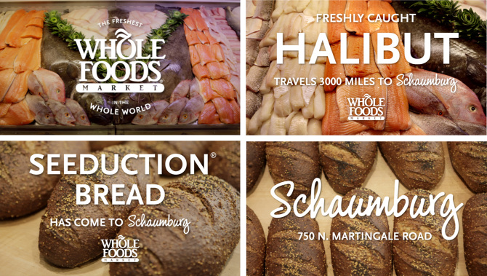
Purple & Brown
Unique
Earthy, Natural, Whole Grains, Eco-friendly
Notes:
Can you guess what the use of purple in labeling is designed to signal to your brain? How about brown? (Click to the next slide to reveal)

Slide 11
In the Aisles
The Supermarket “Planogram”
Notes:
Click to link to this short youtube video, exploring the science of the physical placement of items in your local supermarket.

Slide 12
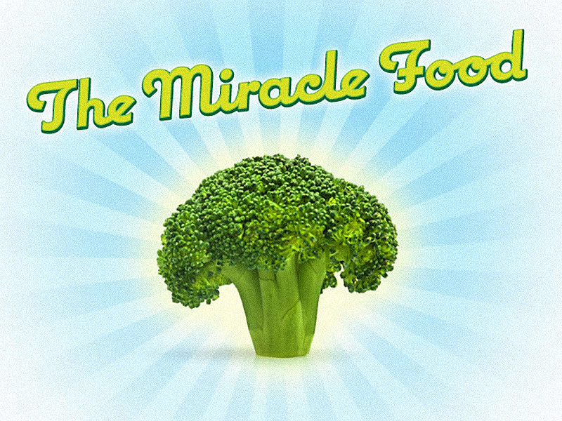
Notes:
Here’s a story about the power of marketing: This ad campaign launched in Canada in 2010. Following the campaign, broccoli sales rose by 8% and perceptions of broccoli as a healthy food rose substantially too. But here’s the twist… it wasn’t a study about broccoli. The backers of the ads were actually the Television Bureau of Canada and it was all about demonstrating the effectiveness of televised commercials.
For anyone who was paying attention during the George H.W. Bush administration, you may remember some ill-thought-out presidential comments on broccoli that had the opposite effect in the States.

Slide 13
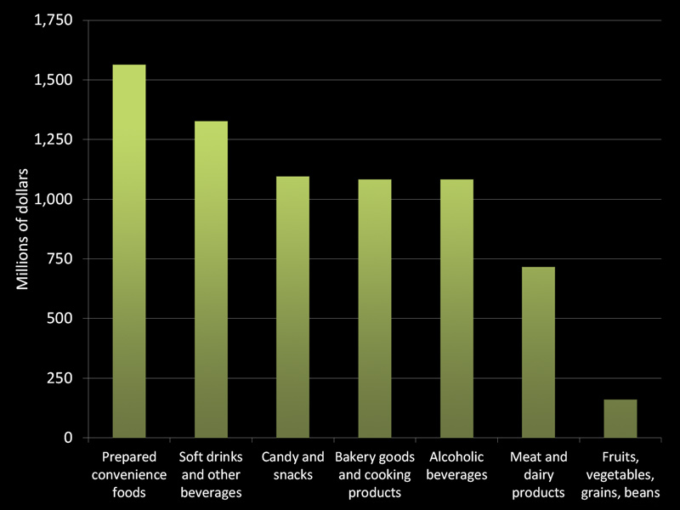
Notes:
But you’re unlikely to see an ad for broccoli. Here’s a peek at food ad spending in the US in 1997… the last year the industry made the breakdown publically available. (I was 5)
And the fact that we don’t advertise for vegetables may have serious consequences. 9 out of every 10 Americans falls short of the recommendations on how much produce to eat.

Slide 14
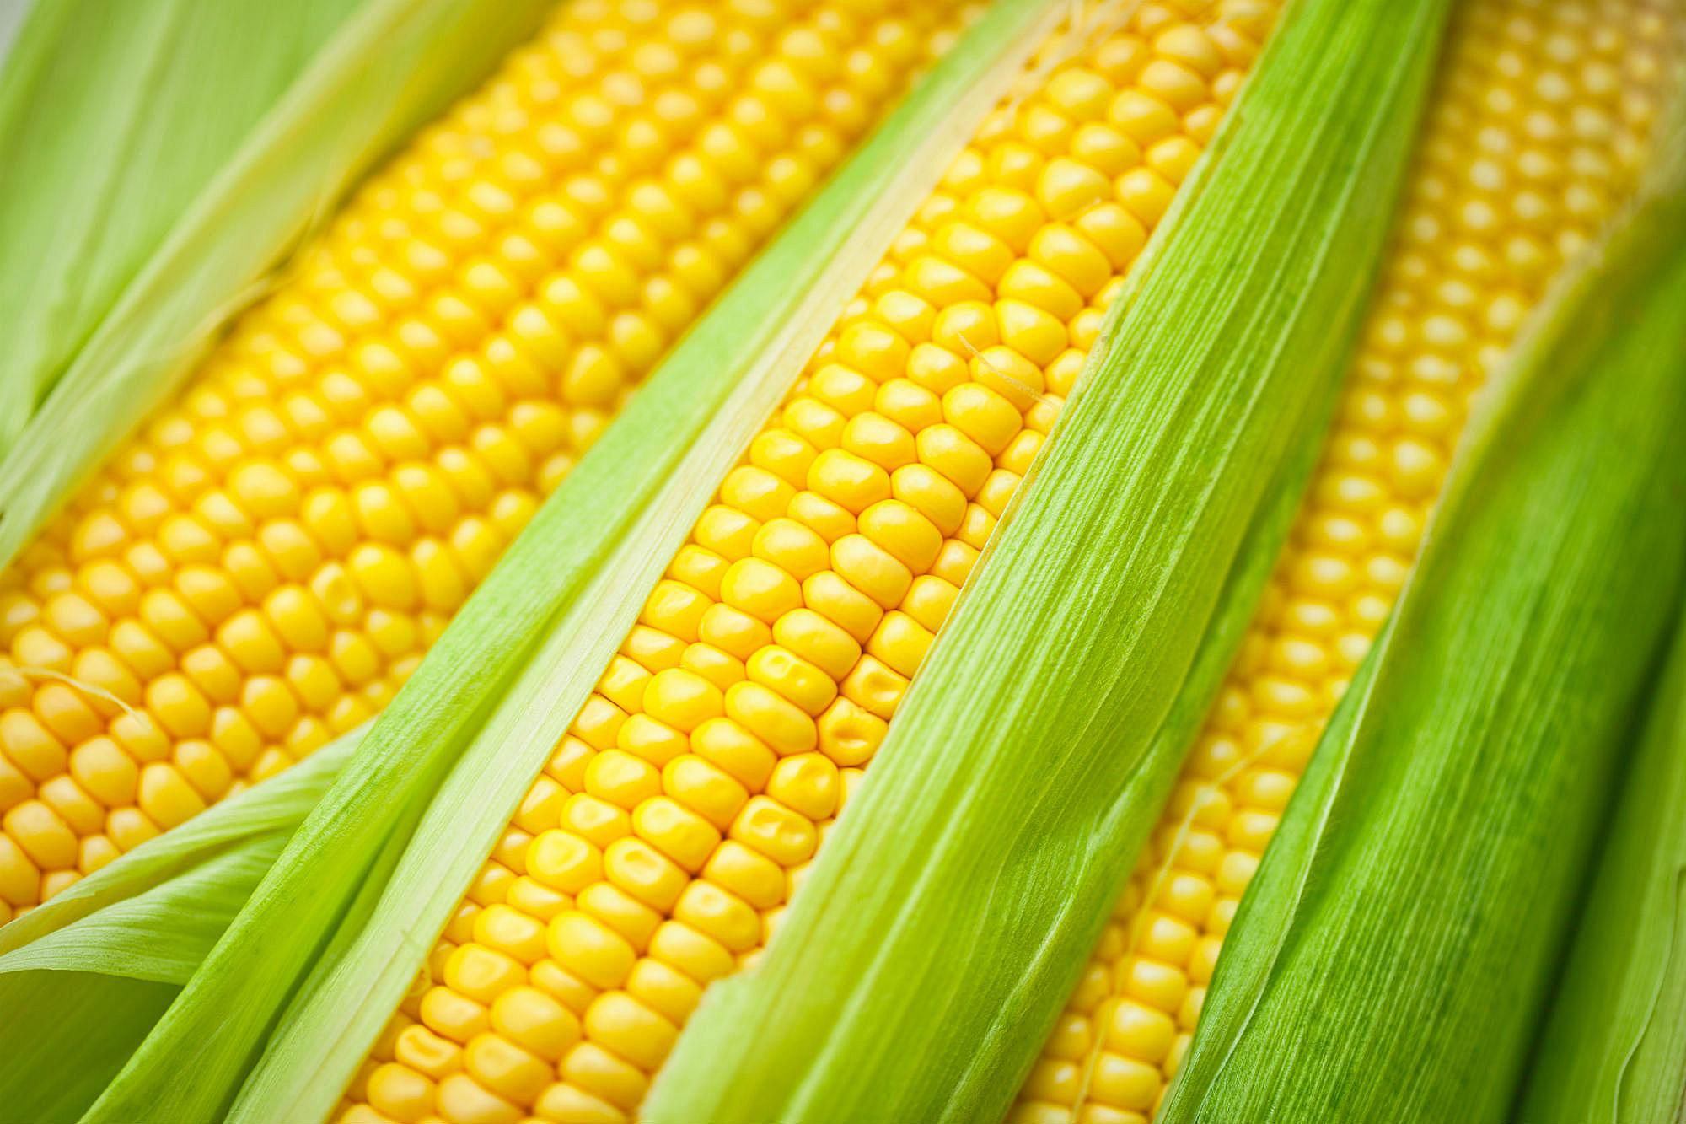
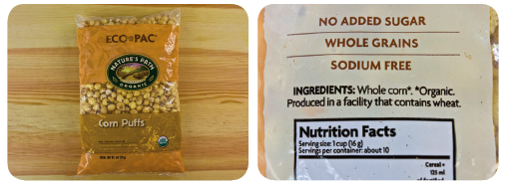
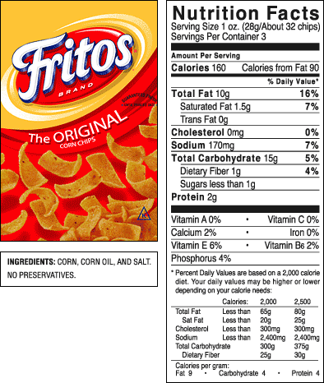
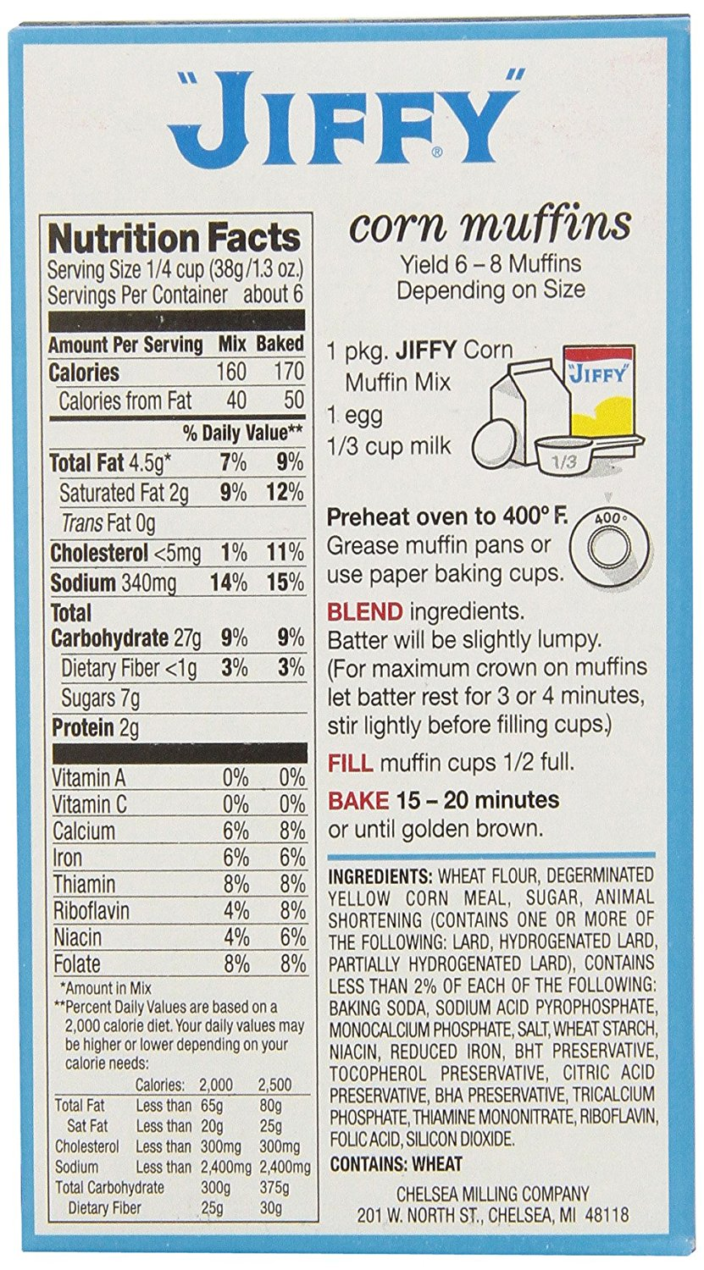
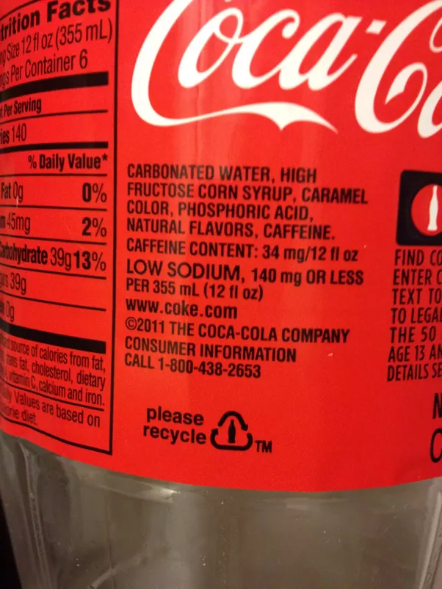
Processed Foods
Notes:
You’ll see that the bulk of that spending was not on broccoli, but rather on processed foods.
Here’s a closer look at what processed foods actually means. From fresh corn on the cob, to these corn crisps with only air added, on down, each product raises the number of ingredients, adds more chemicals I can’t pronounce, and looks less and less like corn.

Slide 15
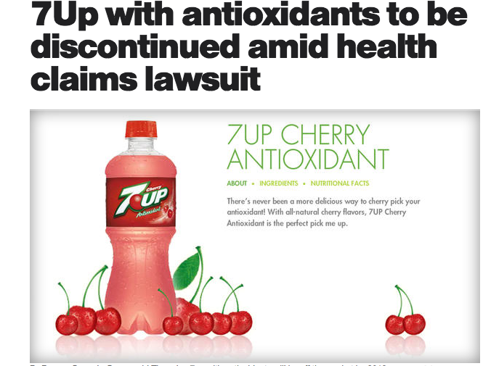
Tricks of the Trade
Misleading Claims
Notes:
So food marketing is pervasive, but only for processed foods.
It might not surprise you to find that it is also often misleading. One of the biggest fibs to look out for is dodgy health claims, like this one for 7Up plus antioxidants. There may have been some antioxidants in there, but they came from artificial sources, because Cherry 7Up contains 0% juice. It’s a similar story with the labeling of new ‘Gluten Free Rice Chex’ and All Natural Lays Potato chips. Rice Chex were always gluten free—they’re made of rice. And Lays didn’t change the recipe for their potato chips, they just took advantage of our growing interest in natural foods.

Slide 16
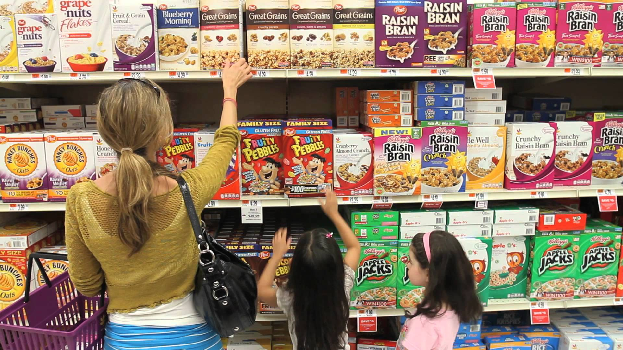
Marketing to Children
Notes:
Adults do fall for tricks like the one with the 7 Up, but once you give it a little thought it is easy to see through them. Children, on the other hand, are a much easier target.
So here we have a scene from the cereal aisle. You can see mom is reaching for the boring, less sugary, wholesome looking box on top. It’s done up in brown-scale, probably aiming for the whole-grain association. Meanwhile, the littles have something else in mind. And the thing is, it isn’t their fault bright colored sugar cereals are what is within reach for them, and from where they stand, Fred Flintstone is actually making eye contact with them. This initiates the Nag reflex, which marketers count on to have these little girls bug mom until she gives in.

Slide 17
Marketing To Children
In 2006, U.S. food and beverage companies spent an estimated $10 billion marketing to youth.
The typical American child saw an estimated 4,787 televised advertisements for food and beverages in 2013—more than 13 per day. Fast food was advertised more than any other product.
Notes:
Here are a few more statistics about just how inescapable food marketing can be for young people--particularly tots who spend a fair amount of time in front of a screen.

Slide 18

Marketing To Children
Children under 8 are developmentally unable to understand that the purpose of ads is to increase sales
Most children under 6 cannot distinguish between commercials and programming.
Brand awareness and loyalty form as early as age 2.
Notes:
And it isn't just a matter of children convincing their parents to buy them the Dora gummies. Commercial food marketers are working on kids because they are tomorrow's customers.

Slide 19
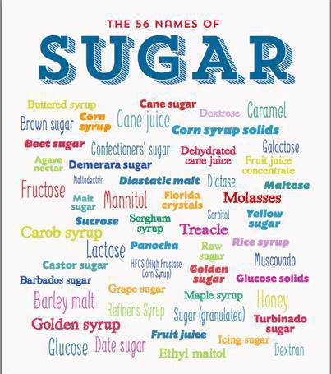
As Sweet as Evaporated Cane Juice
Notes:
So you try to control what you or your family eats. But even if you know your way around a label, there are a few sneaky ways that ingredients like sugar get disguised to fool you into thinking your choice is healthier than you might otherwise believe.

Slide 20
What Can You Do?
The Nutritional Gatekeeper
  Most often the main shopper and the main cook
  Controls 72% of a household’s eating
Control your nutritional content: Make more from fresh foods
Control your shopping environment
  Don’t go hungry
  Take your time
  Say no to nagging
Control your serving environment
  Smaller dishes, blue dishes,
  serve vegetables first
  slow down
Notes:
So what can you do about it? Here are a few tips.

Slide 21
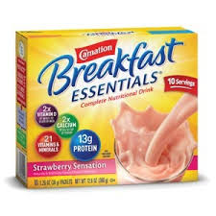
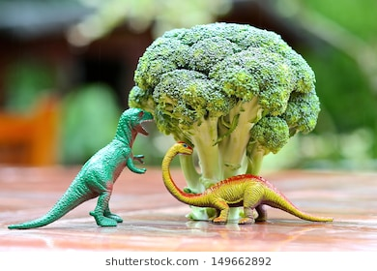
The Emotional Connection
Notes:
It's also worth mentioning the persistent emotional connections formed by foods. On the left is a product that sends shivers down my spine. Two me, those instant breakfast shakes will be forever tied to the painful and stressful childhood experience of having my braces tightened and being unable to chew solid food.
On the other hand, this conflation of food and feelings can be intensely positive. In the book, "Mindless Eating", Brian Wansink details a study on young children's reaction to broccoli. Overall, the researchers found that few children liked broccoli, as it tends to be bitter to young taste buds. However, one particular Kindergarten classroom had a vast majority of students who loved broccoli. By interviewing students, the effect on the full classroom was traced back to one student, whose mom created such excitement about "dinosaur trees" she changed her son's mind. He, in turn, converted his classmates.

Slide 22
Stand Strong!
Cook from scratch
  When you cook, you control the ingredients and nutrition
Become the nutritional gatekeeper
  Don’t allow tempting but nutritionally empty foods in the gate
Consume media critically
  Ask yourself what an advertisement wants to convince you of. Check that against your values.
Use labels
  Remember: the fewer the ingredients, the less processed the food
  The healthiest foods seldom have labels!
Create positive narratives for target foods
Notes:
Use this collection of tips to resist the sway of commercial food marketing and make your own decisions about the foods you prefer in your diet.

Slide 23
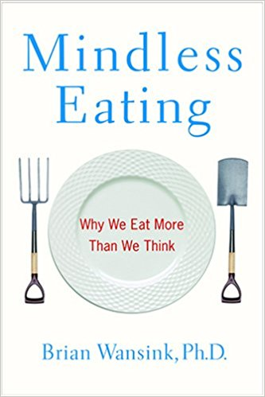
Want to Learn More?
http://www.foodsystemprimer.org/
Contact Grayson- Grayson@alleghenymountainschool.org
Notes:
Where to go from here?
The link above will take you to Johns Hopkin University’s wonderful Center for A Livable Future and the Food System Primer. This class was inspired by a combination of their FoodSpan curriculum (find an adapted version in our “What is the Food System and Where Do I Fit? Class) and the book “Mindless Eating” by Brian Wansink, Ph.D.
A note on “Mindless Eating”: Wansink’s lab recently received some negative press for overstating the significance of the phenomena they present. Take the strength of the research with a grain of salt! However, the strength of “Mindless Eating” is in its practical tips for avoiding overeating through modifying your personal food environment.

Slide 24
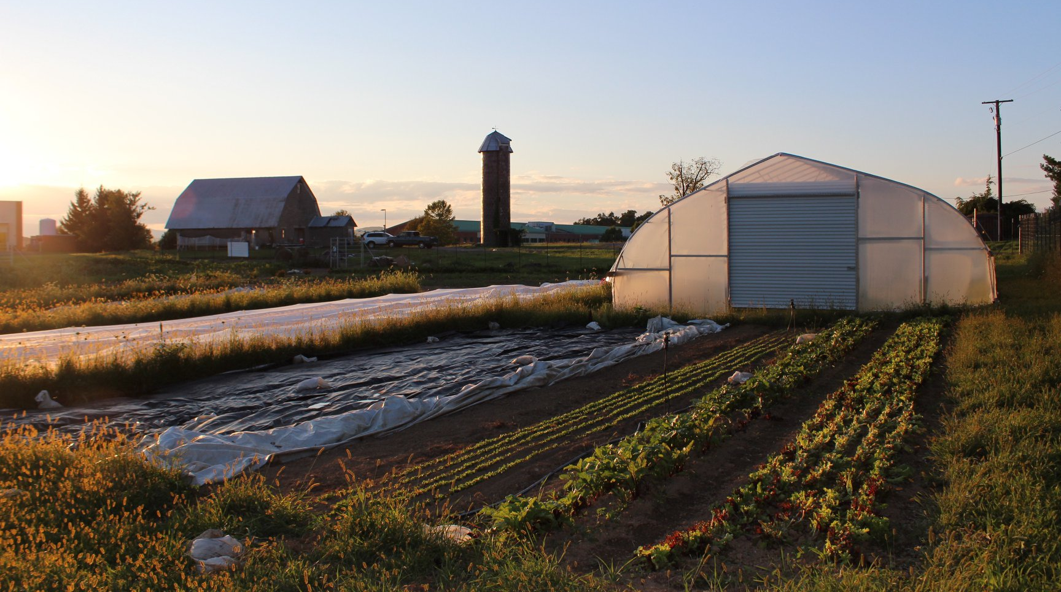
The AMI Farm at Augusta Health
Learn more and register for classes- www.amifellows.org
Contact Grayson at grayson@amifellow.org
Notes:
This class is brought to you by the AMI Farm at Augusta Health: a production and teaching farm nourishing our hospital and community.
The AMI Farm at Augusta Health believes that healthy food is fundamental to excellent preventative healthcare. We’re bringing gardening and food literacy education to people of all ages because today’s food choices matter for long-term health.
Have a student at home, grades 5+? They may enjoy a condensed version of this slide set, paired with the challenge to create an add campaign for a healthy food, using the techniques so often applied to junk food!

Slide 25
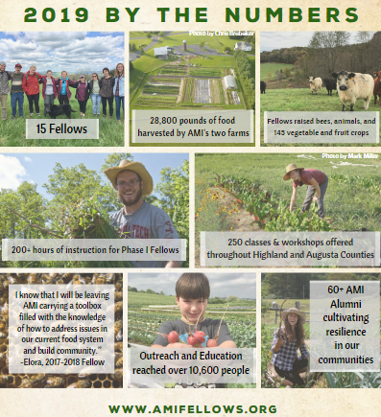

  Allegheny Mountain Institute (AMI) seeks to build healthy communities through food and education. We accomplish this mission through our educational Farm and Food Fellowship, along with the AMI Farm at Augusta Health: a farm to hospital initiative that nourishes and teaches the hospital and community.
Notes:
Want to get in touch with Grayson, your instructor? Use the Feedback and Question Form at www.amifellows.org for any follow-up questions you’d like answered from this course. Email me at Grayson@amifellows.org if you’d like to learn more about Allegheny Mountain Institute, our mission, programming, and the AMI Farm at Augusta Health. And check out www.amifellows.org for more interactive classes! Additional courses will be added as they are created. You can also follow us on facebook and Instagram to stay up to date with all things AMI!

